Slide 1
LECTIRE # 11
REFLEXIVE RELATION
  Let R be a relation on a set A. R is reflexive if, and only if, for all
  a ∈ A, (a, a) ∈R. Or equivalently aRa. That is, each element of A is related to itself.
  REMARK
  R is not reflexive iff there is an element “a” in A such that (a, a) ∉R. That is, some element “a” of A is not related to itself.

Slide 2
EXAMPLE
  Let A = {1, 2, 3, 4} and define relations R₁, R₂, R₃, R₄ on A as follows:
    R₁ = {(1, 1), (3, 3), (2, 2), (4, 4)}
    R₁ is reflexive, since (a, a) ∈R₁ for all a ∈A.
    R₂ = {(1, 1), (1, 4), (2, 2), (3, 3), (4, 3)}
    R₂ is not reflexive, because (4, 4) ∉R₂.

Slide 3
    R₃ = {(1, 1), (1, 2), (2, 1), (2, 2), (3, 3), (4, 4)}
    R₃ is reflexive, since (a, a) ∈R₃ for all a ∈A.
    R₄ = {(1, 3), (2, 2), (2, 4), (3, 1), (4, 4)}
    R₄ is not reflexive, because (1, 1) ∉R₄, (3, 3) ∉R₄

Slide 4
DIRECTED GRAPH OF A REFLEXIVE RELATION
  The directed graph of every reflexive relation includes an arrow from every point to the point itself (i.e., a loop).
  EXAMPLE
  Let A = {1, 2, 3, 4} and define relations R₁, R₂, R₃, and R₄ on A by R₁ = {(1, 1), (3, 3), (2, 2), (4, 4)}
  R₂ = {(1, 1), (1, 4), (2, 2), (3, 3), (4, 3)}
  R₃ = {(1, 1), (1, 2), (2, 1), (2, 2), (3, 3), (4, 4)}
  R₄ = {(1, 3), (2, 2), (2, 4), (3, 1), (4, 4)}
  Then their directed graphs are:

Slide 5

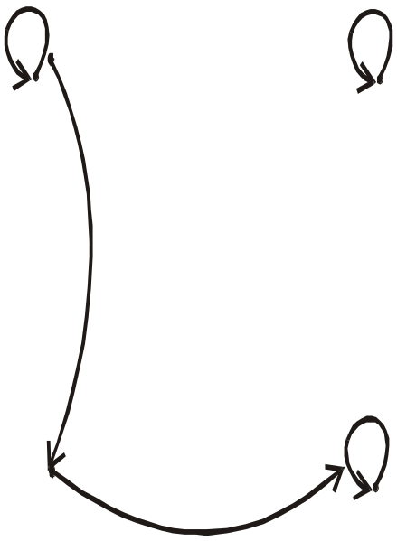
  R₁ = {(1, 1), (3, 3), (2, 2), (4, 4)}
1
2
4
3
R₁ is reflexive
  R₂ = {(1, 1), (1, 4), (2, 2), (3, 3), (4, 3)}
1
2
4
3
R₂ is not reflexive, as there is no loop at 4.

Slide 6
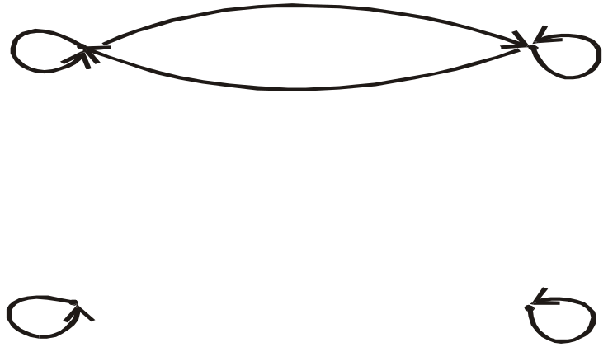
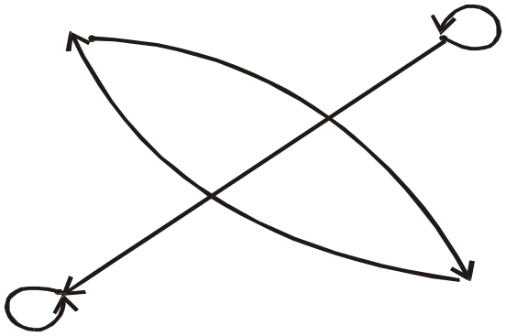
  R₃ = {(1, 1), (1, 2), (2, 1), (2, 2), (3, 3), (4, 4)}
1
2
4
3
R₃ is reflexive
  R₄ = {(1, 3), (2, 2), (2, 4), (3, 1), (4, 4)}
1
2
4
3
R₄ is not reflexive

Slide 7
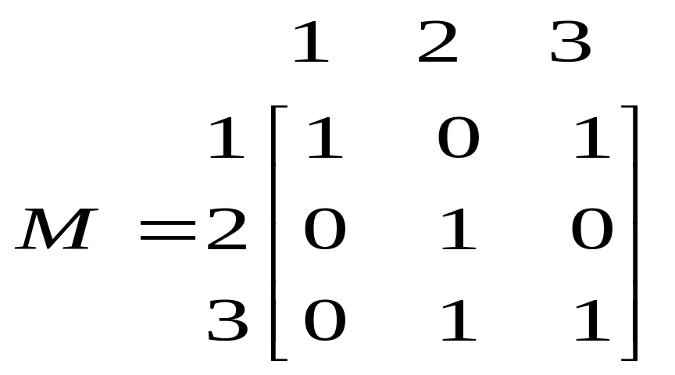
MATRIX REPRESENTATION OF A REFLEXIVE RELATION
  Let A = {a₁, a₂, …, a_{n}}. A Relation R on A is reflexive if and only if
  (a_{i}, a_{i}) ∈R ∀ i=1,2, …,n.
  Accordingly, R is reflexive if all the elements on the main diagonal of the matrix M representing R are equal to 1.
  EXAMPLE: R = {(1,1), (1,3), (2,2), (3,2), (3,3)} on
  A = {1,2,3}

Slide 8
SYMMETRIC RELATION
  Let R be a relation on a set A. R is symmetric if, and only if, for all
  a, b ∈ A, if (a, b) ∈R then (b, a) ∈R.
  That is, if aRb then bRa.
  REMARK
  R is not symmetric if there are elements a and b in A such that (a, b) ∈R but (b, a) ∉R.

Slide 9
EXAMPLE
  Let A = {1, 2, 3, 4}
  R₁ = {(1, 1), (1, 3), (2, 4), (3, 1), (4,2)}
  R₁ is symmetric
    R₂ = {(1, 1), (2, 2), (3, 3), (4, 4)}
    R₂ is also symmetric symmetric
    R₃ = {(2, 2), (2, 3), (3, 4)}
    R₃ is not symmetric, because (2,3) ∈R₃ but (3,2) ∉R₃.
    R₄ = {(1, 1), (2, 2), (3, 3), (4, 3), (4, 4)}
    R₄ is not symmetric because (4,3) ∈R₄ but (3,4) ∉R₄.

Slide 10
DIRECTED GRAPH OF A SYMMETRIC RELATION
  For a symmetric directed graph whenever there is an arrow going from one point of the graph to a second, there is an arrow going from the second point back to the first.

Slide 11
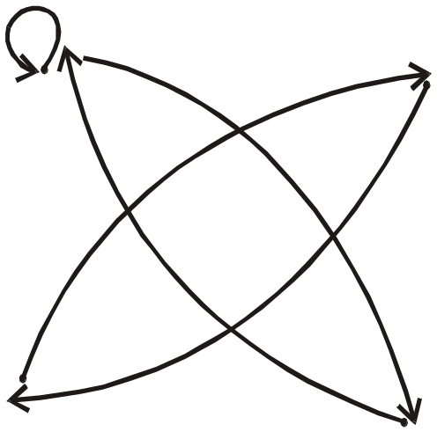
  Let A = {1, 2, 3, 4}
  R₁ = {(1, 1), (1, 3), (2, 4), (3, 1), (4,2)}
  R₂ = {(1, 1), (2, 2), (3, 3), (4, 4)}
2
1
4
3
R₁ is symmetric
1
2
4
3
R₂ is symmetric

Slide 12
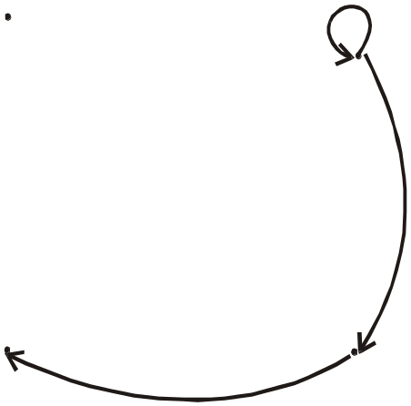

  R₃ = {(2, 2), (2, 3), (3, 4)}
  R₄ = {(1, 1), (2, 2), (3, 3), (4, 3), (4, 4)}
1
2
4
3
R₃ is not symmetric
1
2
4
3
R₄ is not symmetric

Slide 13
MATRIX REPRESENTATION OF A SYMMETRIC RELATION
  Let A = {a₁,a₂, …, a_{n}}. A relation R on A is symmetric if and only if for all a_{i}, a_{j} ∈ A, if (a_{i}, a_{j}) ∈R then (a_{j}, a_{i})∈R.
  Accordingly, R is symmetric if the elements in the ith row are the same as the elements in the ith column of the matrix M representing R. More precisely, M is a symmetric matrix.i.e. M = M^{t}

Slide 14
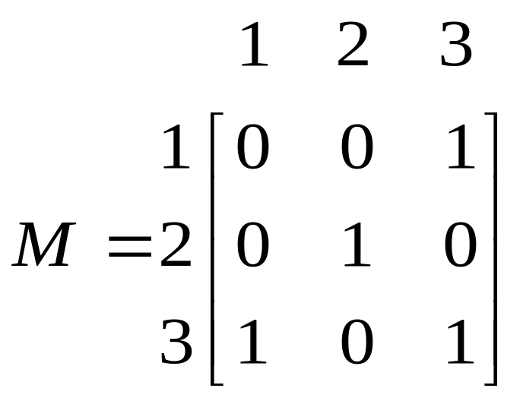
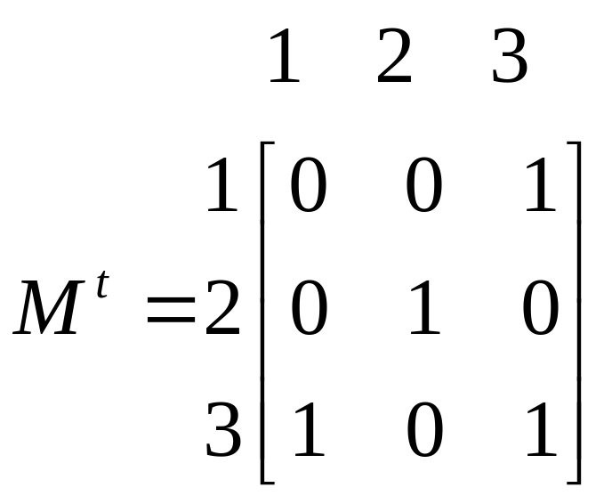
  EXAMPLE
  The relation R = {(1,3), (2,2), (3,1), (3,3)} on A = {1,2,3} represented by the following matrix M is symmetric.

Slide 15
TRANSITIVE RELATION
  Let R be a relation on a set A.R is transitive if and only if for all a, b, c ∈A, if (a, b) ∈R and (b, c) ∈R then (a, c) ∈R.
  That is, if aRb and bRc then aRc.
  REMARK
  R is not transitive if there are elements a, b, c in A such that
  (a,b) ∈R and (b,c) ∈R but (a,c) ∉R.

Slide 16
EXAMPLE
  Let A = {1, 2, 3, 4} and relations R₁, R₂ and R₃ on A as follows:
    R₁ = {(1, 1), (1, 2), (1, 3), (2, 3)}
    R₂ = {(1, 2), (1, 4), (2, 3), (3, 4)}
    R₃ = {(2, 1), (2, 4), (2, 3), (3,4)}
  Then R₁ is transitive.
  R₂ is not transitive since (1,2) and (2,3) ∈R₂ but (1,3) ∉R₂.
  R₃ is transitive.

Slide 17
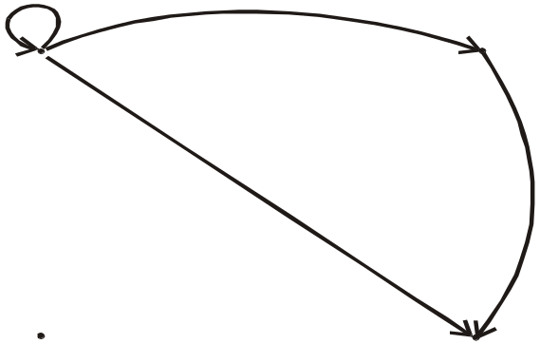
DIRECTED GRAPH OF A TRANSITIVE RELATION
  For a transitive directed graph, whenever there is an arrow going from one point to the second, and from the second to the third, there is an arrow going directly from the first to the third.
  EXAMPLE
  Let A = {1, 2, 3, 4} ,R₁ = {(1, 1), (1, 2), (1, 3), (2, 3)}
1
2
4
3
R₁ is transitive

Slide 18
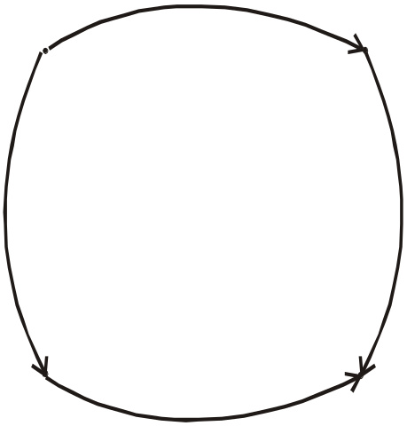
    R₂ = {(1, 2), (1, 4), (2, 3), (3, 4)}
1
2
4
3
R₂ is not transitive since there is an arrow from 1 to 2 and from 2 to 3 but no arrow from 1 to 3 directly

Slide 19
EXERCISE
Let A = {1, 2, 3, 4} and define the null relation φ and universal relation
A × A on A. Test these relations for reflexive, symmetric and transitive properties.
SOLUTION:
Reflexive:
  ∅ is not reflexive since (1,1), (2,2), (3,3), (4,4) ∉ ∅.
  A × A is reflexive since (a,a) ∈ A × A for all a ∈ A.

Slide 20
  Symmetric
  (i) For the null relation ∅ on A to be symmetric, it must satisfy the implication:
  if (a,b) ∈ ∅ then (b, a) ∈ ∅.
  Since (a, b) ∈ ∅ is never true, the implication is true by default. Hence ∅ is symmetric.
  (ii)The universal relation A × A is symmetric, for it contains all ordered pairs of elements of A. Thus, if (a, b) ∈ A × A then (b, a) ∈ A × A for all a, b in A.

Slide 21
  Transitive
  (i) The null relation ∅ on A is transitive, because the implication,
  if (a, b) ∈ ∅ and (b, c) ∈ ∅ then (a, c) ∈ ∅ is true by default,
  since the condition (a, b) ∈ ∅ is always false.
  The universal relation A × A is transitive for it contains all ordered pairs of elements of A.
  Accordingly, if (a, b) ∈ A × A and (b, c) ∈ A × A then (a, c) ∈ A × A as well.

Slide 22
EXERCISE
  Let A = {0, 1, 2} and R = {(0,2), (1,1), (2,0)} be a relation on A.
  Is R reflexive? Symmetric? Transitive?
  SOLUTION
  R is not reflexive, since 0 ∈ A but (0, 0) ∉R and also
  2 ∈ A but (2, 2) ∉R.
  R is clearly symmetric.
  R is not transitive, since (0, 2) & (2, 0) ∈ R but (0, 0) ∉R.

Slide 23
2. Which ordered pairs are needed in R to make it a reflexive and transitive relation?
  For R to be reflexive, it must contain ordered pairs (0,0) and (2,2).
  For R to be transitive, we note (0,2) and (2,0) ∈ but (0,0) ∉R.
  Also (2,0) and (0,2) ∈R but (2,2)∉R.
  Hence (0,0) and (2,2). Are needed in R to make it a transitive relation.

Slide 24
EXERCISE
  Define a relation L on the set of real numbers R be defined as follows:
  for all x, y ∈R, x L y ⇔ x < y.
  Is L reflexive?
  Is L symmetric?
  Is L transitive?

Slide 25
SOLUTION
  L is not reflexive, because x < x for any real number x.
  (e.g. 1 < 1)
  b. L is not symmetric, because for all x, y ∈R, if x < y then y < x
  (e.g. 0 < 1 but 1 < 0)
  L is transitive, because for all, x, y, z ∈R, if x < y and y < z, then
  x < z.

Slide 26
EXERCISE
  Define a relation R on the set of positive integers Z⁺ as follows:
  for all a, b ∈Z⁺, a R b iff a × b is odd.
  Determine whether the relation is
  reflexive b. symmetric c. transitive
  Justify your answer.
  SOLUTION:
  First, recall that the product of two positive integers is odd if and only if both of them are odd.

Slide 27
  reflexive
  R is not reflexive, because 2 ∈ Z⁺ but 2 R 2 for 2 × 2 = 4 which is not odd.
  Symmetric: R is symmetric, because if a R b then a × b is odd or equivalently b × a is odd
  ( b × a = a × b) ⇒ b R a.
  Transitive: R is transitive, because if a R b then a × b is odd ⇒ both “a” and “b” are odd.
  Also bRc means b × c is odd ⇒ both “b” and “c” are odd.
  Now if aRb and bRc, then all of a, b, c are odd and so a × c is odd. Consequently aRc.

Slide 28
EXERCISE
  Let A be a non empty set and P(A) the power set of A. Define the “subset” relation S on P(A) as follows:
  for all X, Y, ∈ P(A),X S Y ⇔ X ⊆ Y.
  Determine the relation is reflexive, symmetric, transitive.
  SOLUTION Reflexive:
  S is reflexive if ∀ X ∈P(A), X S X and by definition of S, this means for all X ∈P(A), X ⊆ X.
  Since every set is a subset of itself, therefore this is true.
  Hence S is reflexive.

Slide 29
  Symmetric: S is symmetric iff ∀ x, y ∈p(a), if X S Y then Y S X
  By definition of S, this means that
  ∀ X, Y ∈P(A), if X ⊆ Y then Y ⊆ X But this is false. Accordingly, S is not symmetric.
  Transitive
  S is transitive iff ∀ X, Y, Z ∈P(A),if X SY and Y S Z then X S Z By definition of S, this means that
  X, Y, Z ∈P(A), if X ⊆ Y and Y ⊆ Z then X ⊆ Z and this is very much true.
  Accordingly, S is transitive.

Slide 30
EXERCISE
  Let “D” be the “divides” relation on Z defined as:
  for all m, n ∈Z, m D n⇔ m|n
  Determine whether D is reflexive, symmetric or transitive. Justify your answer.
  SOLUTION:
  Reflexive
  Let m ∈Z, since every integer divides itself so m|m ∀ m ∈Z therefore m D m ∀ m ∈Z
  Accordingly D is reflexive

Slide 31



  Symmetric
  Let m, n ∈ Z and suppose m D n.
  By definition of D, this means m|n (i.e. = an integer)
  Clearly, then it is not necessary that = an integer.
  Accordingly, if m D n then n D m, ∀ m, n ∈Z
  Hence D is not symmetric.
  Transitive
  Let m, n, p ∈Z and suppose m D n and n D p.
  Now m D n ⇒ m|n ⇒ = an integer.
  Also n D p ⇒ n|p ⇒ = an integer.

Slide 32

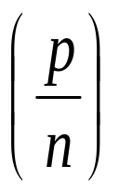
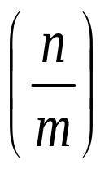
  We note = *
  = (an int) * (an int)
  = an int
        m|p and so mDp
  Thus if mDn and nDp
  then mDp ∀ m, n, p ∈Z
  Hence D is transitive.

Slide 33
EXERCISE
  Let A be the set of people living in the world today. A binary relation R is defined on A as follows:
  for all p, q ∈A, pRq ⇔ p has the same first name as q.
  Determine whether the relation R is reflexive, symmetric and/or transitive.
  SOLUTION:
  Reflexive
  Since every person has the same first name as his/her self. Hence for all p ∈ A, pRp.
  Thus, R is reflexive.

Slide 34
  Symmetric:
  Let p, q ∈A and suppose pRq.
  p has the same first name as q.
  q has the same first name as p.
  q R p
  Thus if pRq then qRp ∀ p,q ∈A.
  R is symmetric.

Slide 35
  Transitive
  Let p, q, s ∈A and suppose p R q and qRr.
  pRq ⇔p has the same first name as q
  qRr ⇔ q has the same first name as r. Consequently, p has the same first name as r.
  pRr
  Thus, if pRq and qRs then pRr, ∀ p, q, r ∈A.
  Hence R is transitive.
  NOTE: R is reflexive, symmetric and transitive.

Slide 36
EQUIVALENCE RELATION
  Let A be a non-empty set and R a binary relation on A. R is an equivalence relation if, and only if, R is reflexive, symmetric, and transitive.
  EXAMPLE:
  Let A = {1, 2, 3, 4} and
  R = {(1,1), (2,2), (2,4), (3,3), (4,2), (4,4), (4,2)}
  be a binary relation on A.
  Note that R is reflexive, symmetric and transitive, hence an equivalence relation.

Slide 37
EXERCISE
  Define a binary relation E (equality) on the set of real number R
  as follows:
  for all x, y, ∈ R, x E y ⇔ x = y.
  Prove that E is an equivalence relation.
  SOLUTION
  E is reflexive
  For all x ∈R, we could write x = x.
  ⇒ For all x ∈R, x E x (By definition of E)
  Hence E is reflexive.

Slide 38
  E is symmetric:
  Let x, y ∈R and suppose x E y.
  Now x E y means x = y
  which is the same as y = x and this is equivalent to y E x
  Thus if x E y then y E x, ∀ x, y ∈R
  Hence E is symmetric.
  E is transitive: Let x, y, z ∈ R and suppose x E y and y E z.
  Now x E y ⇔ x = y and y E z ⇔ y = z
  Combining them we get x = z ⇔ x E z.
  Thus, if x E y and y E z, then x E z. Hence E is transitive.

Slide 39
EXERCISE
  Let A be the set of all straight lines in the Cartesian plane. Define a relation || on A as follows:
  for all l₁ and l₂ in A, l₁ || l₂⇔l₁ is parallel to l₂. Prove that || is an equivalence relation.
  SOLUTION
  || is reflexive.
  Any line in the Cartesian plane is considered to be parallel to itself.
  Hence, for all l ∈ A, l is parallel to l.
  for all l ∈ A, l || l.
  Thus || is reflexive.

Slide 40
  || is symmetric.
  Let l₁, l₂ ∈A and suppose l₁ || l₂.
  l₁ is parallel to l₂. Or l₂ is parallel to l₁.
  l₂ || l₁.
  Thus, if l₁ || l₂ then l₂ || l₁, ∀ l₁, l₂ ∈A.
  ⇒ || is symmetric.
  || is transitive. Let l₁, l₂, l₃ ∈A and suppose l₁ || l₂ and l₂ || l₃.
  Now l₁ || l₂ ⇔l₁ is parallel to l₂ and l₂ || l₃ ⇔ l₂ is parallel to l₃.
  Consequently, l₁ is parallel to l₃ ⇔ l₁ || l₃.
  ⇒ || is transitive

Slide 41
CONGRUENCES
  Let m and n be integers and d be a positive integer. The notation
  m ≡ n (mod d)
  means that
  d | (m – n) {d divides m minus n}.There exists an integer k such that
  (m – n) = d ⋅ k

Slide 42
EXAMPLE
  Is 22 ≡ 1(mod 3)?
  b. Is –5 ≡ +10 (mod 3)?
  c. Is 7 ≡ 7 (mod 3)?
  SOLUTION
  a. Since 22-1 = 21 = 3×7.
  Hence 3|(22-1), and so
  22 ≡ 1 (mod 3)
  Since – 5 – 10 = - 15 = 3 × (-5), Hence 3|((-5)-10), and so
  - 5 ≡ 10 (mod 3)
  Since 7 – 7 = 0 = 3 × 0, Hence 3|(7-7), and so 7 ≡ 7 (mod 3)

Slide 43
EXERCISE
  Define a relation R on the set of all integers Z as follows:
  for all integers m and n,
  m R n ⇔ m ≡ n (mod 3)
  {This relation is called congruence modulo 3}.
  Prove that R is an equivalence relation.
  SOLUTION:
  R is reflexive.
  R is reflexive iff for all m ∈Z, m R m.
  By definition of R, this means that for all m ∈Z, m ≡ m (mod 3)
  Since m – m = 0 = 3 ×0. Hence 3|(m-m), and so m ≡ m (mod 3)
  ⇔ mRm
  ⇒ R is reflexive.

Slide 44
  R is symmetric.
  R is symmetric iff for all m, n ∈Z, if m R n then n R m.
  Now mRn ⇒ m≡n (mod 3)
  ⇒ 3|(m-n)
  ⇒ m-n = 3k, for some integer k.
  ⇒ n – m = 3(-k), -k ∈Z
  ⇒ 3|(n-m)
  ⇒ n ≡ m (mod 3)
  ⇒ nRm
  Hence R is symmetric.

Slide 45
  R is transitive: R is transitive iff for all m, n, p ∈Z, if mRn and nRp then mRp
  Now mRn and nRp means
  m ≡ n (mod 3) and n ≡ p (mod 3)
  3|(m-n) and 3|(n-p)
  (m-n) = 3r and (n-p) = 3s for some r, s ∈Z
  Adding these two equations, we get,
  (m – n) + (n – p) = 3 r + 3 s
  m – p = 3 (r + s),
  where r + s ∈Z
  3|(m – p)
  m ≡ p (mod 3) ⇔ m Rp
  Hence R is transitive.

